Slide 1
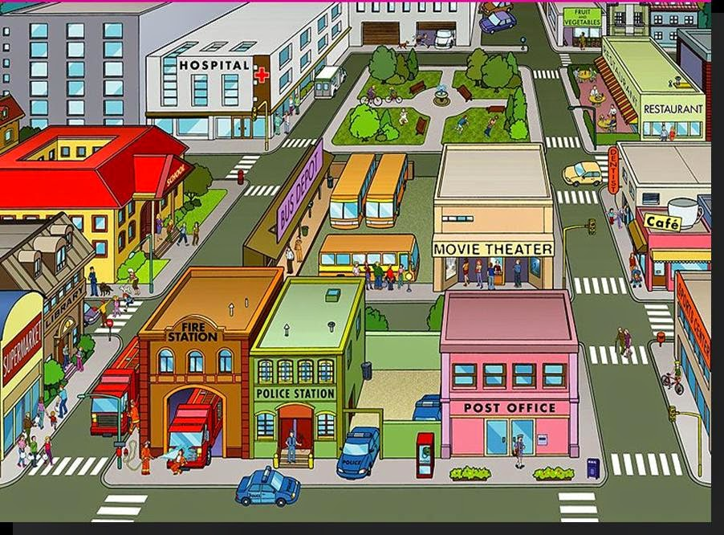

Travel around the city
Where is the …??

Slide 2
Aims:
1. Rules of behavior
2. Places to visit in the city
3. Asking and giving directions
4. Making up dialogues

Slide 3



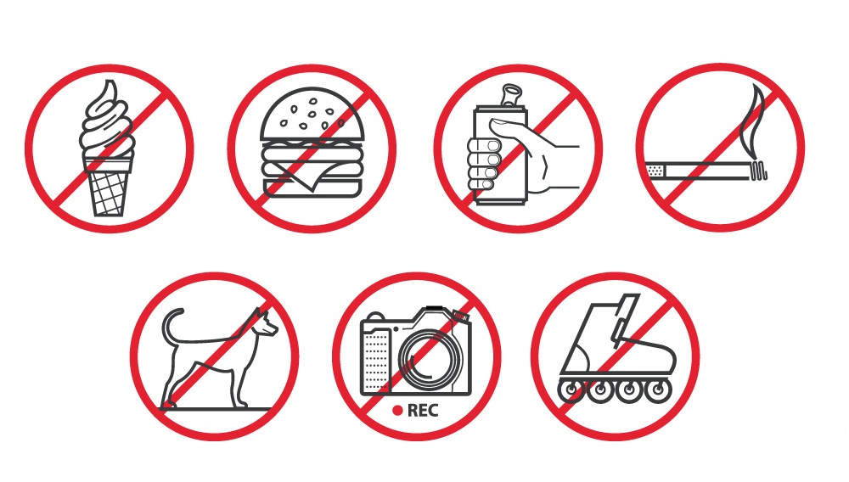
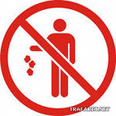

YOU MUST / YOU MUSTN’T
Litter
Turn off phones
Take photographs
Be quiet
stop at the red traffic light

Slide 4
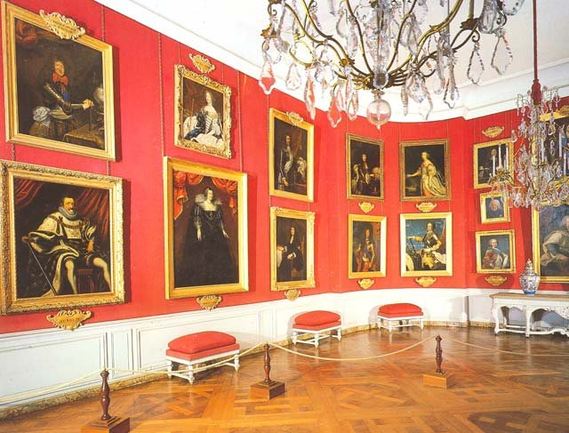
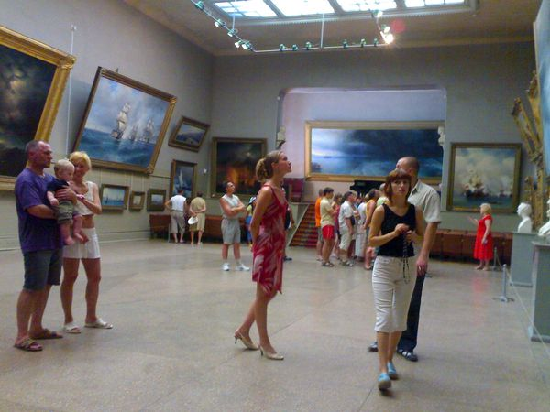
PLACES TO GO
ART GALLERY

Slide 5

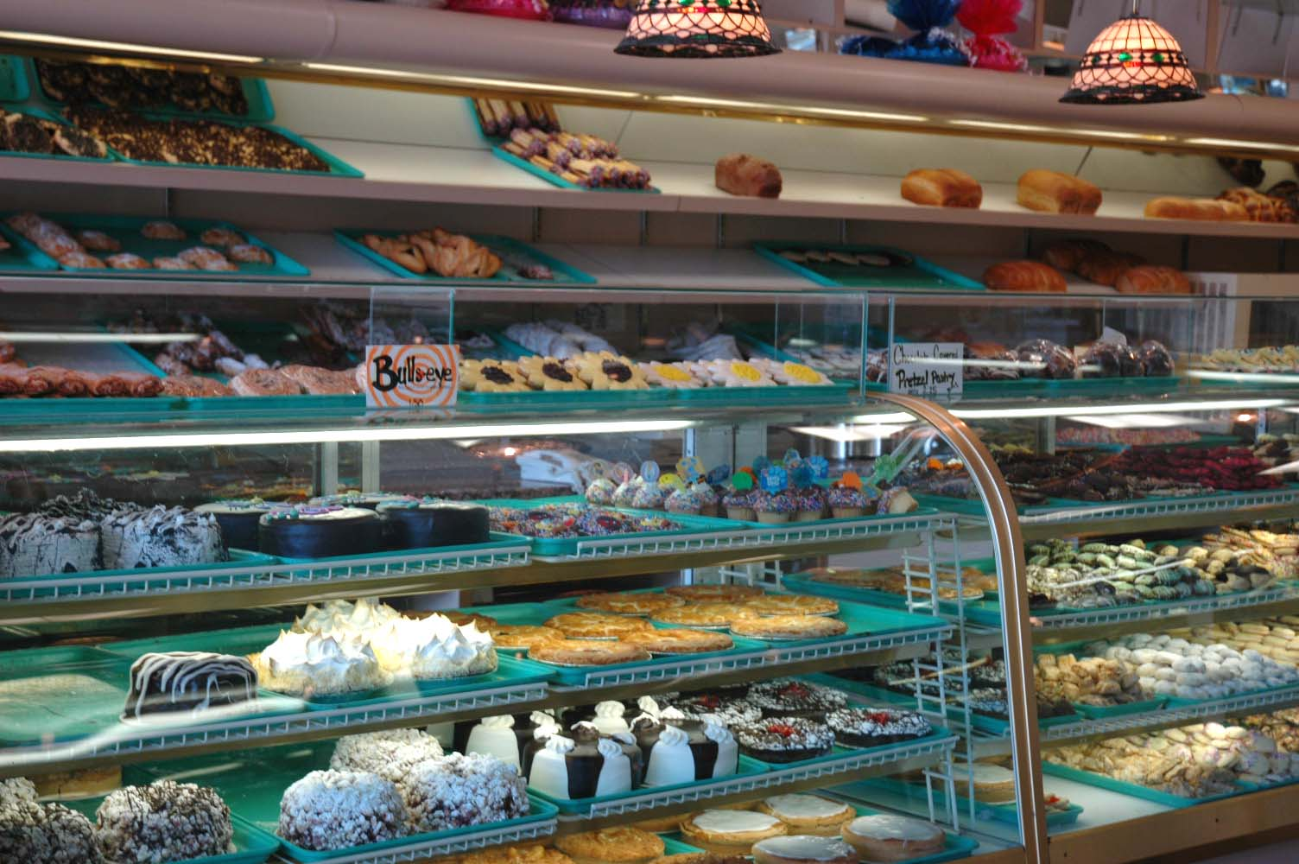
PLACES TO GO
BAKERY

Slide 6
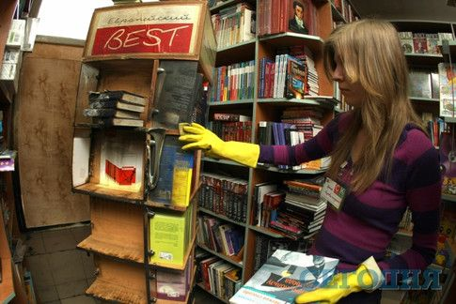
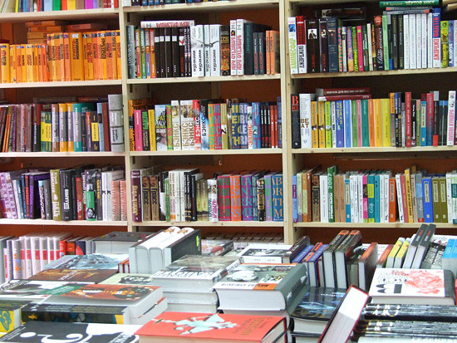
PLACES TO GO
BOOKSHOP / LIBRARY

Slide 7
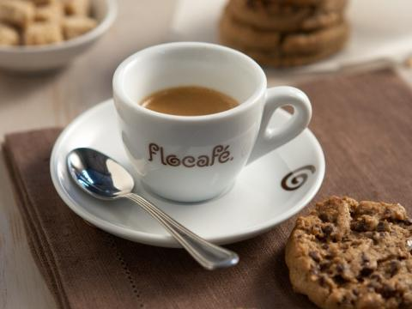
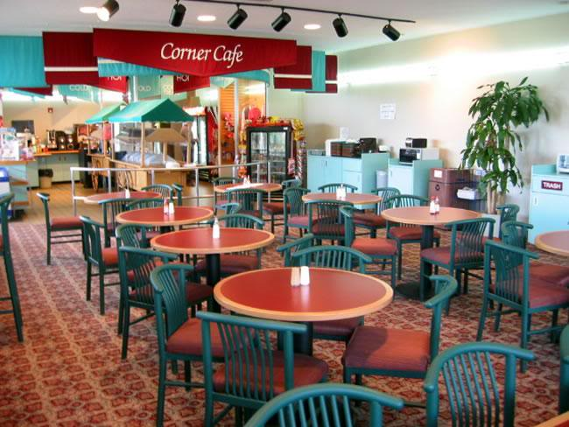
PLACES TO GO
CAFE

Slide 8

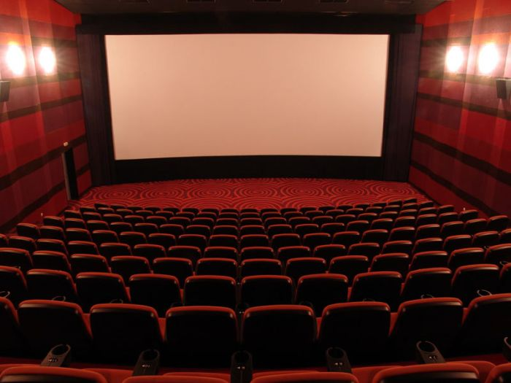
PLACES TO GO
CINEMA

Slide 9

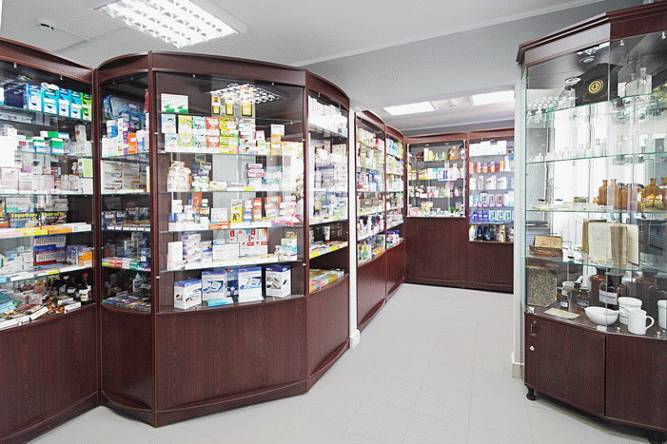
PLACES TO GO
CHEMIST’S

Slide 10
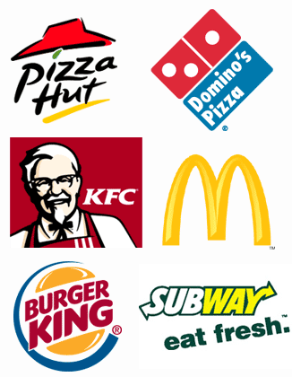
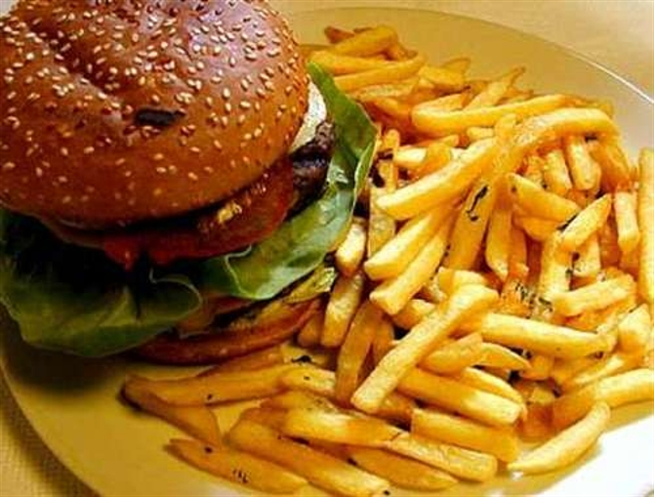
PLACES TO GO
FAST FOOD RESTAURANT

Slide 11
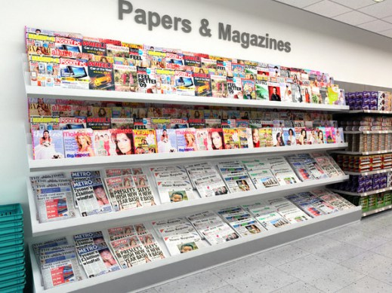
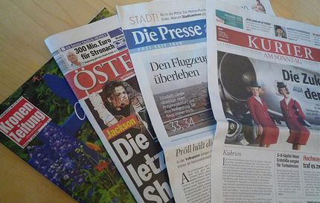
PLACES TO GO
NEWSAGENT’S

Slide 12
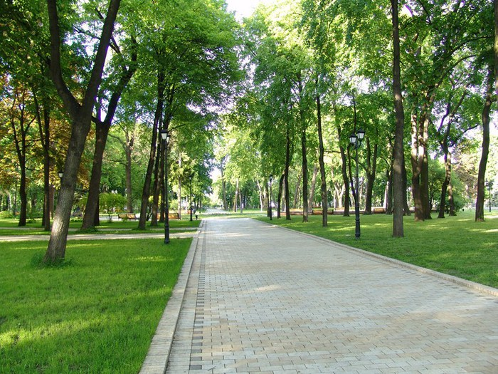
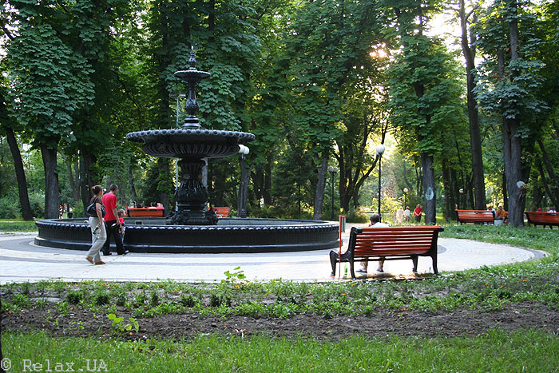
PLACES TO GO
PARK

Slide 13
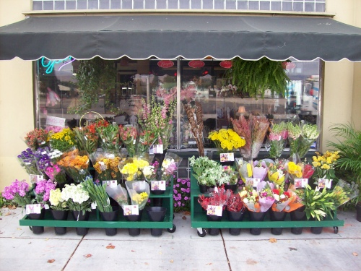

PLACES TO GO
Florist’s

Slide 14
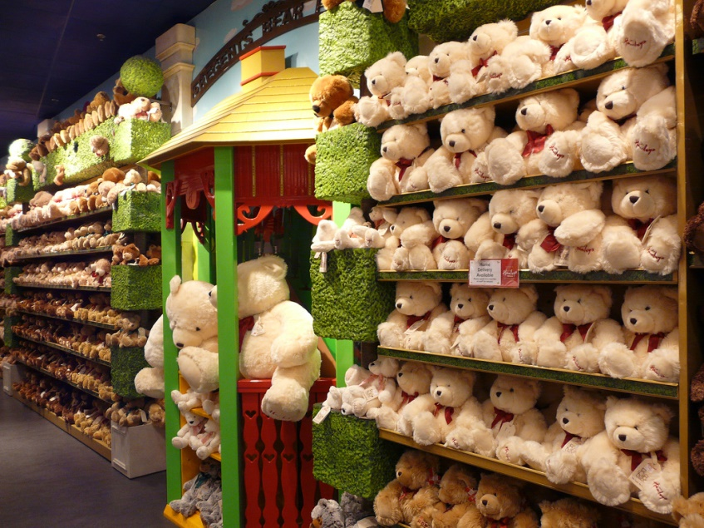
PLACES TO GO
Toy shop

Slide 15
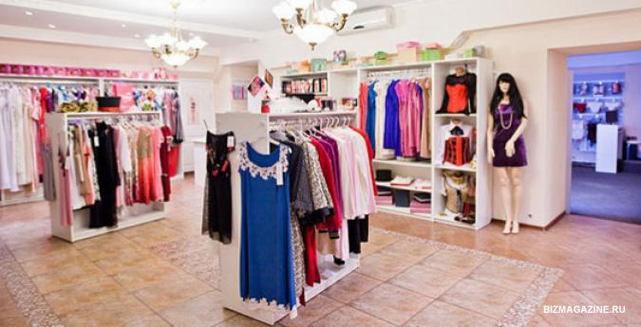
PLACES TO GO
Clothes Shop

Slide 16
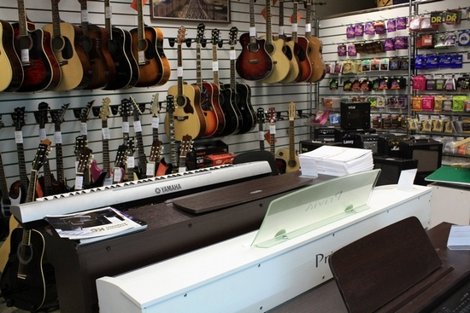
PLACES TO GO
Music Shop

Slide 17
VOCABULARY
words | transcription
direction | [ daɪrekʃ(ə)n ]
street | [striːt]
road | [roud]
corner | ['kɔːnə]
opposite | ['ɔpəzɪt]
turn | [tɜːn]
straight | [streɪt]
Can you tell me how do get to…
Where exactly?

Slide 18
ASKING FOR DIRECTIONS | GIVING DIRECTION
WHERE IS THE…? | TURN RIGHT/ LEFT
HOW DO I GET TO …? | GO STRAIGHT ON
COULD YOU TELL ME HOW TO GET TO…? | GO UP/ GO DOWN THIS STREET
WHERE EXACTLY? | CROSS THE ROAD
 | IT’S ON THE CORNER OF…
 | IT’S NEXT TO/ NEAR/ OPPOSITE/ BETWEEN
 | IT’S ON YOUR LEFT/RIGHT

Slide 20
FEEDBACK
Now I know
Now I can
It was interesting
It was difficult

