Slide 1
!HELLO, CHILDREN!
HOW ARE YOU?

Slide 2
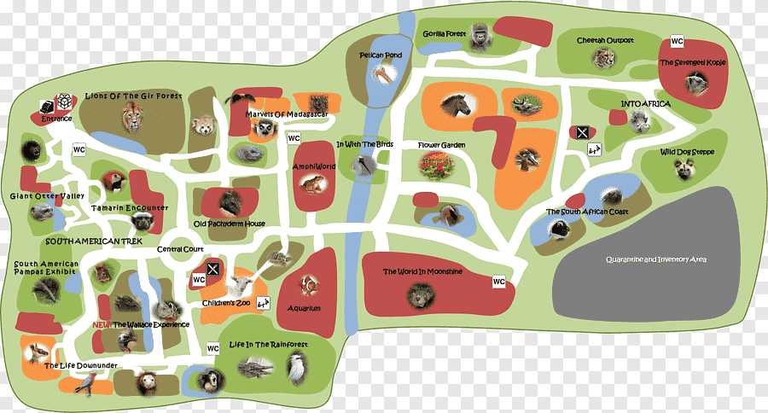


Slide 3
TASK 2
The 1st variant GREEN TICKER
COME UP WITH SYNONYMOUS
The 2nd variant BLUE STICKER
FIND SYNONYMS FROM THE TEXT

Slide 4
TASK 3
The 1st variant GREEN TICKER
ANSWER QUESTIONS
The 2nd variant BLUE STICKER
ASK QUESTION USING IT’S ANSWER
The 3rd variant PINK STICKER
PUT THE WORDS IN RIGHT ORDER

Slide 5
!THE LESSON IS OVER!
Thank you

