Slide 1
«TO WRITE THE LETTER WE SHOULD…»
CONTINUE THE PHRASE

Slide 2
LET’S CHECK
•make the greeting on a separate line
•thank him or her for the letter
•react on what a pen friend wrote about
•answer him or her three questions
•express the hope for future contact
•wish all the best
•make a signature on a separate line

Slide 3
WE HAVE GOT LETTERS!
Ben writes:
Ben writes:
Ben writes:
…I am so fond of Japanese cartoons, that I’ve decided to learn Japanese. Mum says it’s hard, but I think it’s worth it. Besides, their writing is cool! …
…What languages do you learn at school? What other language would you like to learn, why? What do you think about my choice of Japanese?
…Yesterday I did a test to see which job is the most appropriate for me. According to the results I should become a doctor. But it would be absolutely impossible because I am afraid of blood…
…What future career would you like to have, why? Do your parents agree with your choice? In what way will English be useful for your career?
…My granny is such a kind person. She always brings us presents for everything we celebrate. And I love all her presents! For example, at Christmas she gave me the coolest computer game, it was something I had been dreaming of …
…What holidays do you celebrate with your family? What is your favourite holiday and why? What is the best present you’ve ever received?

Slide 4
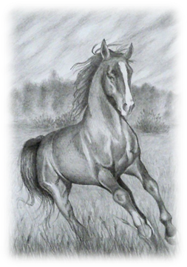
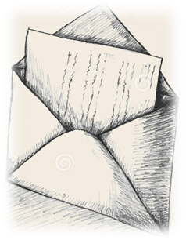
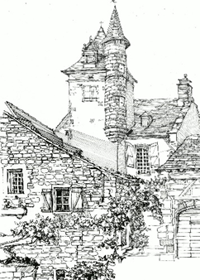
Create an answer to the letter or
Recreate the answer from phrases
The answer
The answer
The answer
Thanks for I was very glad to hear from you again. I think it is great, that you’ve decided to learn Japanese. In your letter you asked me about languages. I am glad to answer you. I learn Russian, English and German at Helen school. I would like to learn Greek language. It is your letter. important Best wishes, because the science began from Dear Ben, Greek. Your choice philosophy of learning Japanese is correct, I’m proud of you and I wish you success in it. That’s all for now. I’d better go now as I need to help my mum with cooking. Take care and keep in touch.
Best wishes, Thanks for your letter. I was very glad to hear from you again. I think, your granny is really kind person. Her Christmas present is really cool. I am glad to In your letter you asked me some questions. answer you. I celebrate the New Year and Birthday with my family. My favourite holiday is my birthday because everyone comes to me with a present. I’d better go now as I need to help The best present I have ever received is the laptop my mum presented me last year. That’s all for now Dear Ben,. Write back soon. Sam my dad with repairing our car.
Sam Write back soon. you can help people every day like a doctor. Thanks for your letter. I was very glad to hear from you again. I think you don’t have to be a doctor, In your letter you asked me some questions. I’d better go now as I need to read I am glad to answer you. I’ve been dreaming about my future That’s all for now. career. Best wishes, Dear Ben, I would like to be a teacher of History. My a book to answer tomorrow at the history lesson. parents agree with my choice. English will be useful for my career, because I am planning to teach our history to foreign students.

Slide 5
MAKE YOUR CHOICE
Create OR Recreate?

Slide 6
LET’S WRITE
YOU HAVE 30 MINUTES

Slide 7

LET’S CHECK
Dear Ben,
Thanks for your letter. I was very glad to hear from you again. I think it is great, that you’ve decided to learn Japanese.
In your letter you asked me about languages. I am glad to answer you. I learn Russian, English and German at school. I would like to learn Greek language. It is important because the science began from Greek philosophy. Your choice of learning Japanese is correct, I’m proud of you and I wish you success in it.
That’s all for now. I’d better go now as I need to help my mum with cooking.
Take care and keep in touch.
Best wishes,
Helen
110

Slide 8
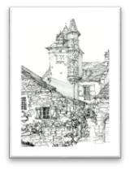
LET’S CHECK
Dear Ben,
Thanks for your letter. I was very glad to hear from you again. I think, your granny is really kind person. Her Christmas present is really cool.
In your letter you asked me some questions. I am glad to answer you. I celebrate the New Year and Birthday with my family. My favourite holiday is my birthday because everyone comes to me with a present. The best present I have ever received is the laptop my mum presented me last year.
That’s all for now. I’d better go now as I need to help my dad with repairing our car.
Write back soon.
Best wishes,
Sam
108

Slide 9
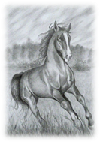
LET’S CHECK
Dear Ben,
Thanks for your letter. I was very glad to hear from you again. I think you don’t have to be a doctor, you can help people every day like a doctor.
In your letter you asked me some questions. I am glad to answer you. I’ve been dreaming about my future career. I would like to be a teacher of History. My parents agree with my choice. English will be useful for my career, because I am planning to teach our history to foreign students.
That’s all for now. I’d better go now as I need to read a book to answer tomorrow at the history lesson.
Write back soon.
Best wishes,
Sam
115

Slide 10
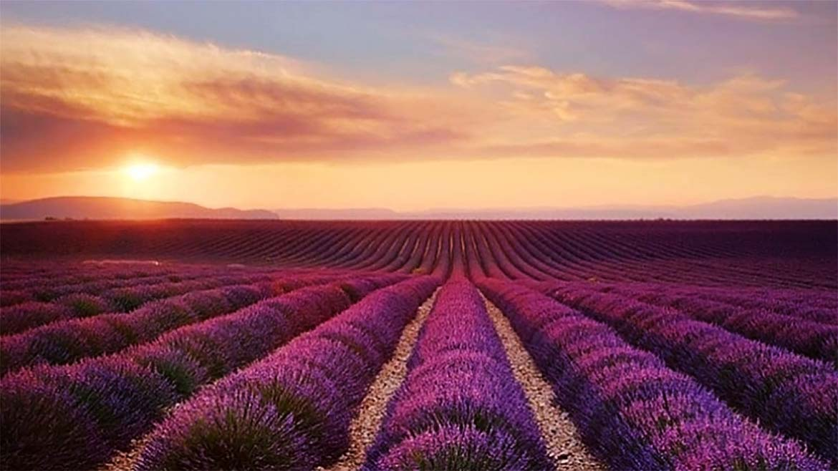
THANK YOU FOR YOUR
ATTENTION!

