Slide 1
https://xn--82-kmc.xn--80aafey1amqq.xn--d1acj3b/program/19253-kruzhok-volshebnye-uzory

Slide 2
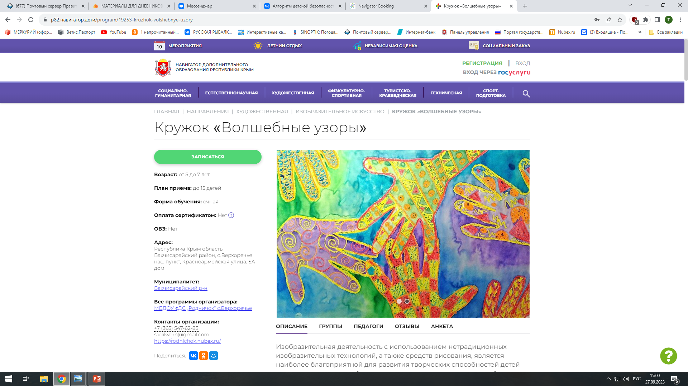

Slide 3
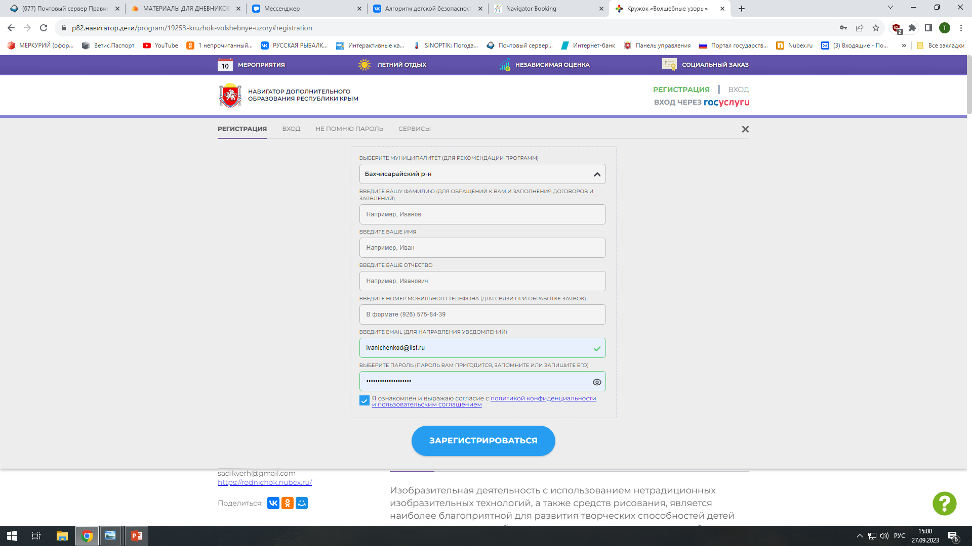

Slide 4
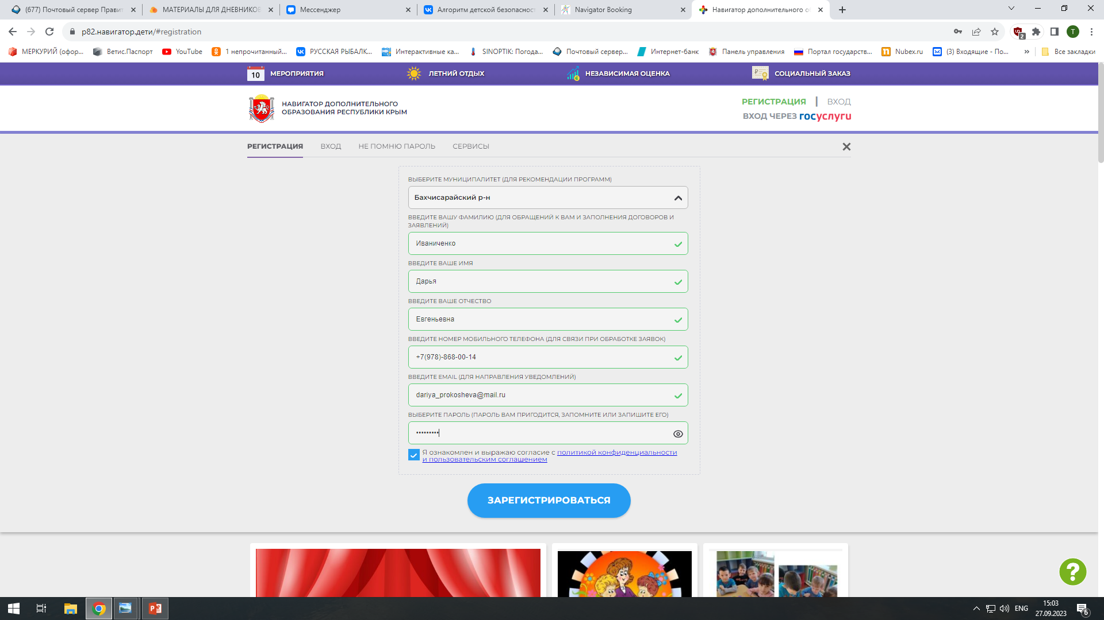

Slide 5
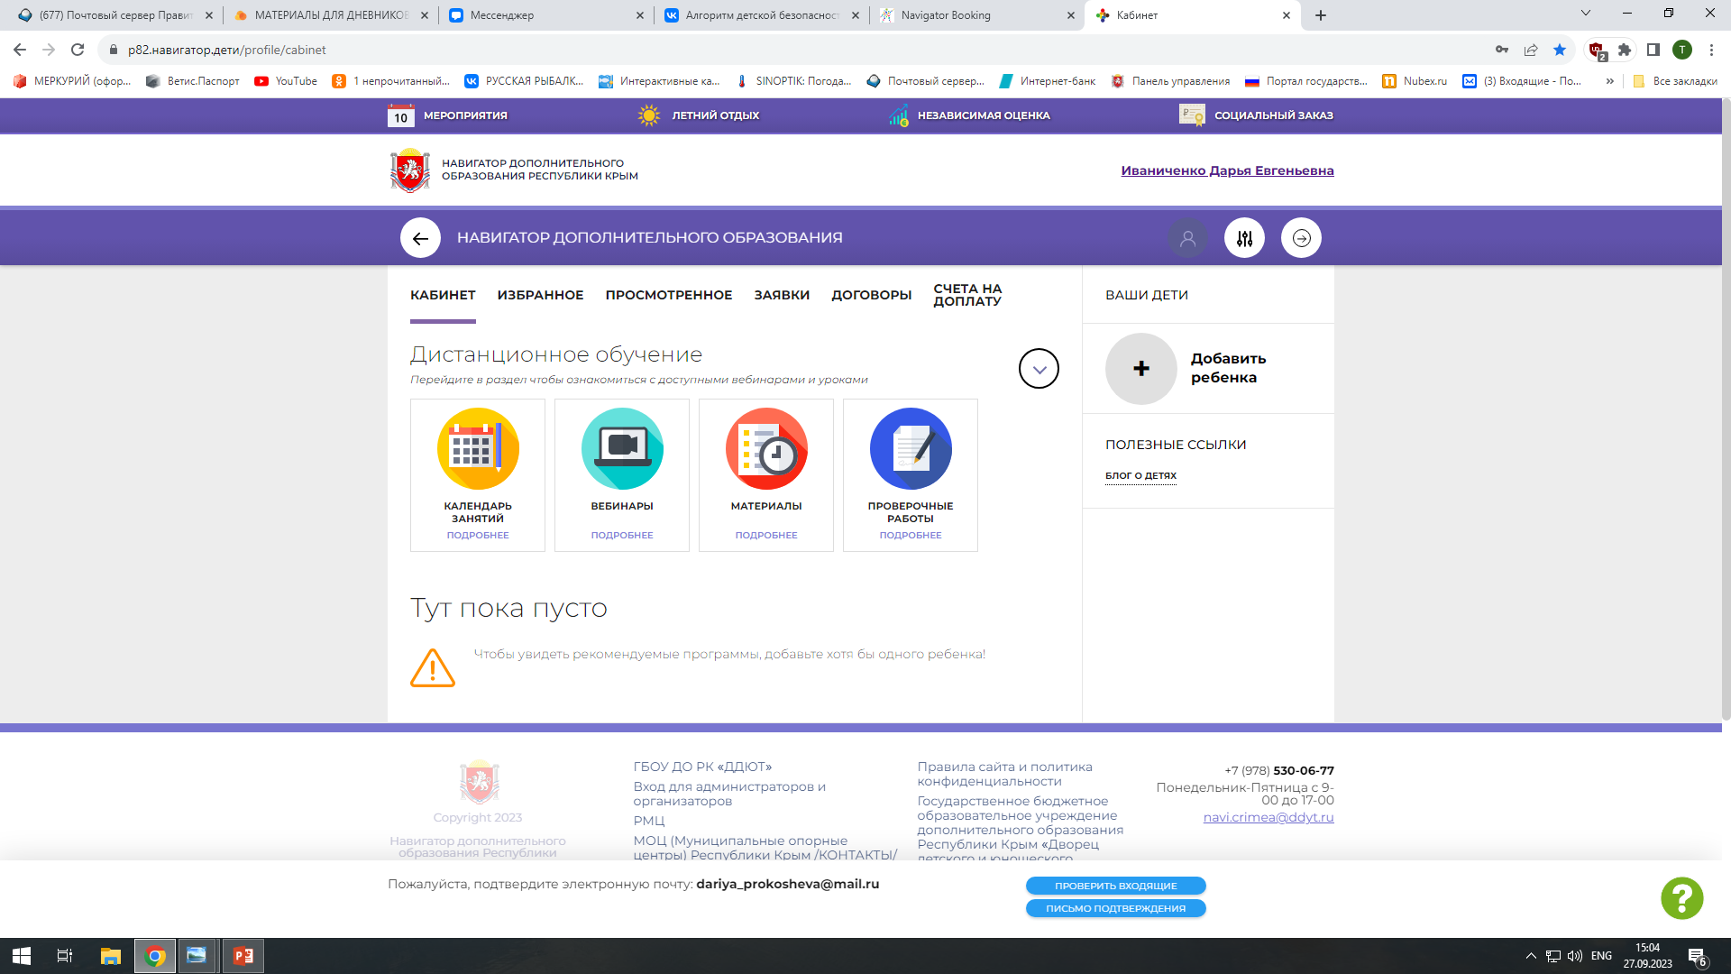

Slide 6
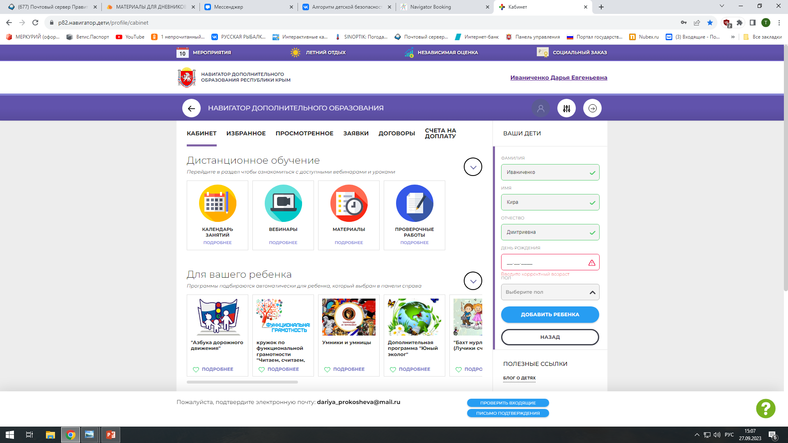

Slide 7
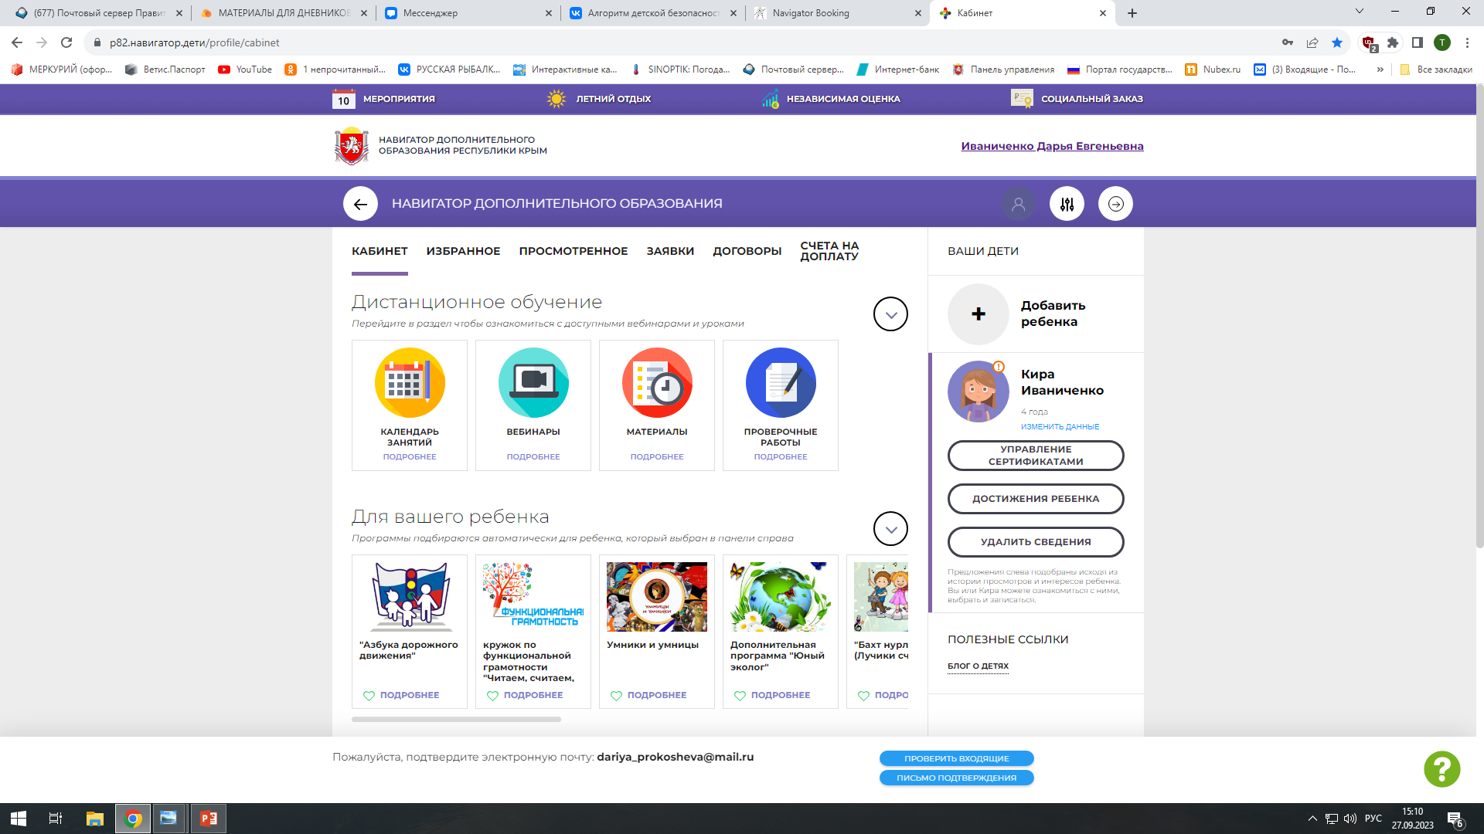

Slide 9
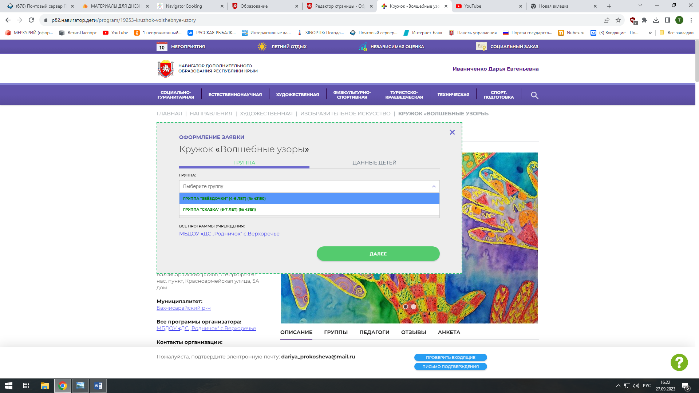

Slide 10
