Slide 1
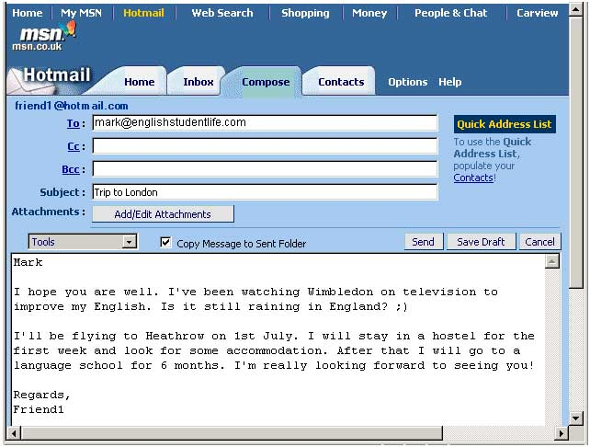
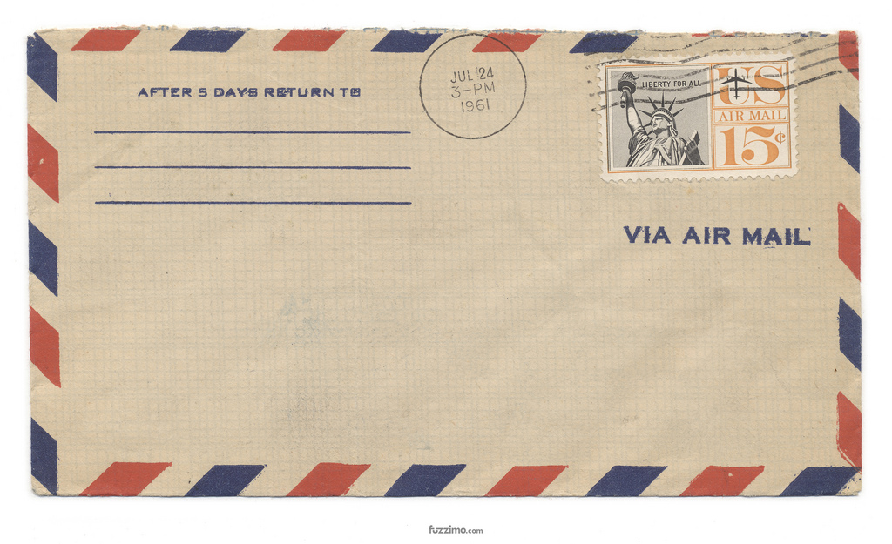
How to write an informal letter / e-mail
mark@melnikviktoriya.com
Мельник Виктория Викторовна

Slide 2
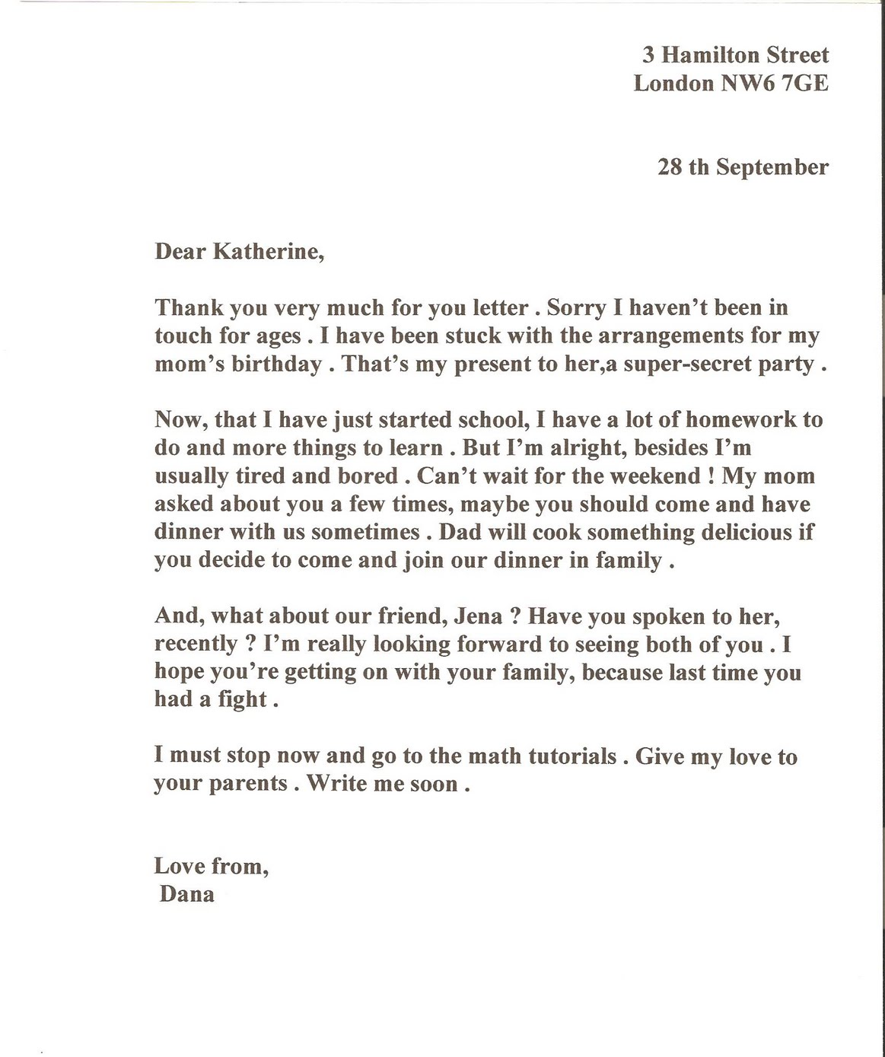
Your address
Date
An informal greeting
Opening remarks
A main body
An informal ending
A conclusion
An informal ending
Your name
Informal letters/emails are sent to people you know well (friends, relatives) about your recent news, personal problems, information you need etc. They are written in an informal style with a chatty, personal tone. An informal letter/email consists of: • an informal greeting (Dear Mary/Uncle Jim, Dear Mum, etc) • an introduction in which you write your opening remarks. (asking about your friend's health etc) and mention the reason for writing
Hi! How's it going? I just thought I'd drop you a line ... • a main body in which you write about the subject of the letter/email in detail, starting a new paragraph for each topic • a conclusion in which you write your closing remarks. I've got to go now. Write back soon... • an informal ending (Love/Take care/Best wishes/Yours etc + your first name.

Slide 3
To: jackras@gmail.com
From: normev@bk.ru
Subject: shopping
Dear Jack, How are you? Sorry I've taken so long to answer, but my computer broke down last week, and I only managed to get it working today. Anyway, I'm really glad your sister is visiting London. The best place for her to go shopping is Camden Town in north-west London. There is a huge variety of colourful indoor and outdoor flea markets, international food stalls, clothes stalls, music stalls and street vendors. There's nothing you can't find at Camden Market, from vintage clothing to antiques, all at bargain prices! I was there last Saturday with my friend Jill. She bought a beautiful embroidered handbag that goes with all her clothes and I bought a pair of 70s style second-hand jeans, some rare comic books for my collection, and a small leather purse, all for £15. Can you believe it? After our shopping, Jill and I enjoyed some Chinese rice noodles and sweet and sour chicken at one of the food stalls. I’m sure your sister will find what she wants there. London is a great place for shopping, and I’d be glad to show her round if she wants. Have to go now. I’ve got a project to finish for Monday. Your friend, Evelyn

Slide 4
True /False
1. You needn’t write the date at the end of the letter.
2. You need to have paragraphs in the letter.
3. You should avoid using contractions (don’t, can’t, etc.).
4. You should use phrasal verbs.
5. You needn’t ask questions in your letter.
6. Punctuation is important.
7. You need to write your name and surname at the end of the letter.

Slide 5
CHOOSE THE RIGHT ANSWERS
Address a) London b) Hamilton Street,4 , London NW676E c) 4 Hamilton Street London, NW676E d) London UK
Date a) The 9 March b) 9th March / March 9th, 2012 c) March the 9th d) The ninth of March
Greetings a) Dear Miss Alison, b) Dear Alison, c) Alison! d) Hi, Alison
Ending a) Good bye! b) Yours sincerely, c) Love, d) Best wishes,

Slide 6
25 Pushkin Street Kerch 295000 Russia
17th June, 2016
Dear Pam,
Thanks for your letter. It was great to hear from you and to hear about your skiing trips. I’m glad you had a good time!
I’ve taken so long to write back because I’ve been busy studying for my exams. They’re over now, and I think I’ve passed everything, except physics, of course.
The only other news is that my brother Andrew has got a new girlfriend. She’s quite nice actually, and I think we’re going to get on really well.
How about you? Have you finished your exams yet? What do you think about coming to Bristol next week? It would be great to see you!
Anyway, that’s all for now. Please write soon and tell me when you can come and visit.
Best wishes,
Alison

